Slide 1
GOSCIENCE TRAINING: ENHANCING COMPREHENSION IN SCIENCE EDUCATION
Methods and instruments for enhancing comprehension in science education
22-26 October 2018, Vidin, Bulgaria
2017-1-BG01-KA201-036209

Slide 2
Use of analogies and metaphors
An analogy is a similarity between concepts. Analogies can help students build conceptual bridges between what is familiar and what is new.
Analogies can serve as early “mental models” that students can use to form limited but meaningful understandings of complex concepts.
When students study new concepts, meaningful learning proceeds when they find and visualise connections between a newly taught context and what they already know. This is especially important in inquiry learning where connections are built between familiar and non-intuitive science contexts. If the analogies are appropriate, they promote concept learning because they encourage students to build links between past familiar knowledge and experiences and new contexts and problems.

Slide 3
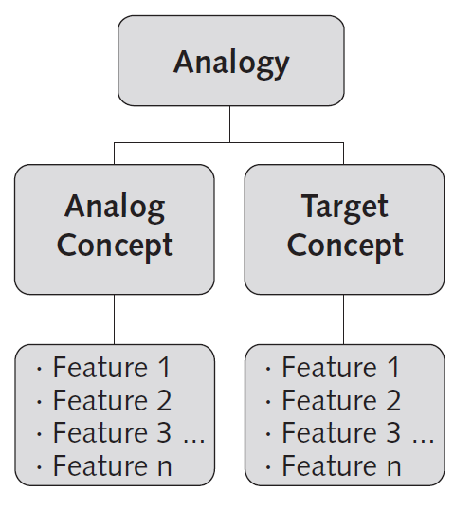
Use of analogies and metaphors
An analogy is a comparison of the similarities of two concepts.
The familiar concept is called the analogue concept and the unfamiliar one the target concept. Both the analogue and the target have features (also called attributes). If the analogue and the target share similar features, an analogy can be drawn between them. A systematic comparison, verbally or visually, between the features of the analogue and target is called a mapping.

Slide 4
Use of analogies and metaphors
A metaphor is a figure of speech that describes an object or action in a way that isn’t literally true, but helps explain an idea or make a comparison.
A metaphor states that one thing is another thing
Metaphors are a form of figurative language, which refers to words or expressions that mean something different from their literal definition.
Love is a battlefield.
I am titanium.
Neurons as trees and the brain as a forest.

Slide 5
Use of models
The word “model” denotes the interpretation of concepts or relations used in a theory, rule, instruction, or another notion by expressing them by/through well-known, familiar phenomena and natural, conventional relation that creates a conception that is easy to perceive intuitively -image.
It may be a drawing, an animation, a scheme and so on. It should be emphasized that models are made by the students, but the teacher act as an organizer and guide of the process of making models.
The models require an equalization of complicated science systems to a certain process or phenomenon one can observe in everyday life.
With models it becomes possible for a student to build an interrelation between his previously gained knowledge about the world order and the complex information of science just by using the occurring associations.
An association originated in this way and in the framework of the mentioned approach is called a comprehension model.

Slide 6
Use of illustration, explanation and colloquialism
Together with analogies illustration, explanation and colloquialism are strategies to convey scientific meaning to students in a way they can more easily understand it and relate it to the already existing knowledge they possess.
Illustration | Speaker gives several examples to illustrate a concept.
Explanation | Attempt by the speaker to define a scientific jargon word he/she uses.
Colloquialism | A simplification of a scientific concept in everyday language that does not have a precise scientific meaning.

Slide 7
Use of illustration, explanation and colloquialism
Illustration: Speaker clarifies a discipline-specific science word by giving one or several examples of familiar scenarios that can be compared in terms of scope or scale. Illustrative phrases differ from analogies in that they are direct comparisons and share the same properties of the original phrase – for instance, describing how cold something is by listing other cold objects. Examples include:
“By tiny I mean much smaller than not even a human hair, but less than a thousandth of a human hair, or even smaller.”
“[...] if you were to take ten Antarcticas, put them all together, and put them into your freezer, you wouldn’t even be even close to this cold as we go.”
Explanation: Speaker attempts to provide a description of the characteristics or mechanisms of a discipline specific concept. The explanation is often given as a definition of the word or phrase. Explanations differ from analogies and illustrations in that they are not explicitly comparative. Examples include:
“A vacuum is essentially a place that has no air”
“I take molecules, which are just small (...) groups of atoms put together”
Colloquialism: Speaker employs informal language to describe a discipline-specific science phrase in place of more precise terminology. Verbs or adjectives that are familiar to the audience are used instead. Examples are:
“ [...] that’s really just a big word for saying we shoot lasers at things and see what happens.”
“[...] those atoms are going to wiggle around inside that material.”

Slide 8
Use of art and drama in science classes
Combining the arts and drama standard curricula together can create a richer and more lasting learning experience for students who believe that learning science is boring in classes.
Drama and arts on their own are an educational area developing and training a child and at the same times an effective method developing creativity.
The main goal of implementing arts in science education is to give students the opportunity to express their thoughts and feelings in the context of their different cultures and background also to understand science through the lens of their creative activity in arts.
Arts and drama require the active participation of the students and thus help them to transform the conceptual information offered by the science lesson to personal experience and thus remember it more easily. Examples of art and drama activities and how to be implemented in class are given in point 3 below.

Slide 9
Use of science concept maps
A concept map is a graphical representation of the relationship among terms.
As students are introduced to new science concepts, they embark on a cognitive process of constructing meaning and making sense by consciously or subconsciously integrating these new ideas with their existing knowledge.
Concept maps provide a unique graphical view of how students organize, connect, and synthesize information. As a result, concept mapping offers benefits to both students and teachers. Concept maps give students an opportunity to:
think about the connections between the science terms being learned
organize their thoughts and visualize the relationships between key concepts in a systematic way
reflect on their understanding.
Usually concept maps are defined into two main groups:
hierarchical – represent information in descending order of importance
non-hierarchical – represent information in cluster or network pattern.

Slide 10
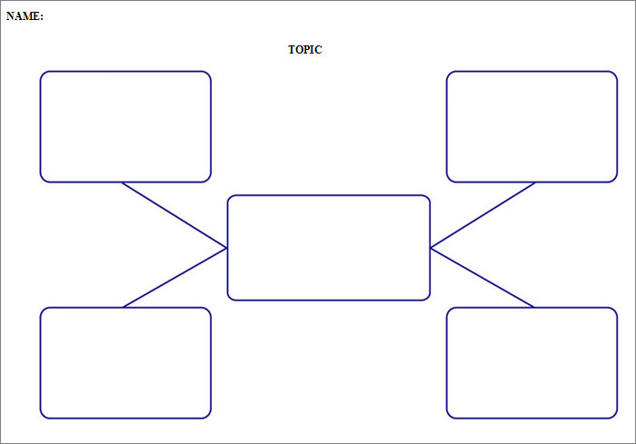

Slide 11
GOSCIENCE.EU
https://www.facebook.com/goscienceproject/
2017-1-BG01-KA201-036209

Slide 12
Thank you for your attention!
„This project has been funded with support from the European Commission.
This publication [communication] reflects the views only of the author, and the
Commission cannot be held responsible for any use which may be made of the
information contained therein.”

